Slide 1
Introduction to Technical Writing
Week 1, Chapter 1

Slide 2
Technical Writing
“Technical writing conveys specific information about a technical subject to a specific audience for a specific purpose.”

Slide 3
Technical Writing
What is technical writing?
  Writing (communication) is an essential skill for all professionals
  Technical writing is the writing of those involved in the technical fields, i.e., science and engineering.
In science and engineering
  Write technical reports
  Write technical proposals
  Various forms of technical communication

Slide 4
1
Technical writing is broadly defined by the Society of Technical Communication as “any form of communication that shows one of more of the following qualities:
  Communicating about technical or specialized topics, such as computer applications, medical procedures, or environmental regulations.
  Communicating by using technology, such as web pages, help files, or social media sites.
  Providing instructions about how to do something, regardless of how technical the task is or even if technology is used to create or distribute that communication.”

Slide 5
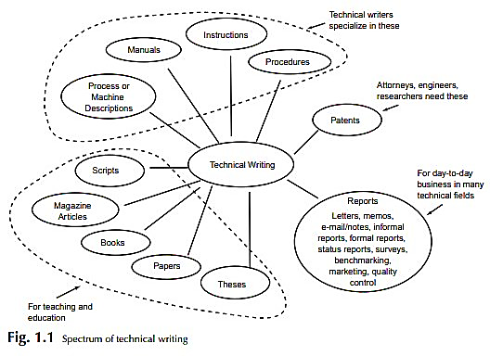

Slide 6
Attributes of Technical Writing
has a degree of formality
focuses on a specific subject with the purpose of making something happen or sharing useful information or knowledge
pertains to a technical subject
has a purpose
has an objective
conveys information/facts/data
is impersonal

Slide 7
Attributes of Technical Writing
is concise
is directed
is performed with a particular style and in a particular format
is archival
cites contributions of others

Slide 8

Basic purposes of technical writing
2
To Inform
To Instruct
To Reference
To Persuade

Slide 9
Prominent Technical Writing Areas
Financial Services
Manufacturing, Energy
Consulting
Medical Business
Engineering
Technical writers work in software, consulting, academia, government, broadcasting, transportation, energy, telecommunications, health, security, publishing

Slide 10
The Technical Writing Process
3
Audience Analysis
gather as much information as possible about who will use the document.
  expertise in the field
  totally new to them
  if they fall somewhere in between
Their own expectations and needs
Determine what the reader is looking for when they begin to read the document.

Slide 11

To understand your reader, ask yourself the following questions:
Who are they?
What do they need?
Where will they be reading?
When will they be reading?
Why will they be reading?
How will they be reading?

Slide 12
User Experience
keep in mind how the document itself services their needs
Tendency for experts to craft a document that shows their depth of knowledge and to compile it in a way that is appealing for their own peer-group.
It’s an easy mistake that ignores how the actual reader will use the document.
Always write a document that is useful to the user.

Slide 13
Mapping and Planning Your Document
A mind-map.
Include a wide range of information, highlight relationships and have a high-level, visual overview
Highlight areas that are not familiar to you and require more investigation.
Highlight any topic areas that you need to research before writing.

Slide 14
Consulting with Experts
Experts will provide additional or parallel information that will make the information more useful to the end reader.
They may be colleagues, client contacts or external experts who are authorities on your topic.
Engage with subject matter experts early in the process.
Maintain contact throughout because they can add value at different stages, especially during the review.

Slide 15
Documentation Preparation
Technical Reports
  Written to provide information, analysis, instructions and/or recommendations.
  Provide the reader with enough background on a topic to be informed and potentially make decisions.
  Example: A technical report on one phase of a company’s manufacturing process will include information on how this phase impacts the product, the process itself, and recommendations for optimization.

Slide 16
Documentation Preparation
Technical Manuals
  Provide instructions on how to use a device or program.
  The user or sometimes a developer of that product
Examples: user manual for a vehicle; instruction manual for an alarm clock; developer’s manual for a computer program

Slide 17
Documentation Preparation
Emails
  Brief form of communication, which vary depending on the goal.
  Intend to share information, with a potential additional use to persuade or instruct.
Example: an email written to all employees with an update on human resource policy changes.

Slide 18
Documentation Preparation
Technical Proposals
  Provide an introduction to a new project.
  Describes the purpose, the planned phases or tasks, methods to be employed, expected results and benefits, and a budget.
  Acts as an outline for the project if accepted.
Examples: a technical proposal from a franchisee to a retail company to open a new location. The proposal includes real estate details, renovation and operations plans, revenue expectations, and project costs.

Slide 19
Documentation Preparation
Specifications
  A detailed outline of the structure, design, materials, packaging, and standards of a product or process
  A level of detail that allows an external party to construct or reconstruct it.
Example: An architect provides specifications for construction of a house to a building contractor

Slide 20
Documentation Preparation
Technical Specification Datasheets
  Provide the technical features, characteristics with a level of detail that allows an external party to include it within another system.
Example: a computer manufacturer provides a technical specification datasheet for a personal computer with detailed information on its operating system, ports, and compatibility so that a customer can connect the computer to their company’s network.
Guides and Handbooks
  Guides and handbooks are references or sets of instructions in a form that is quickly accessible.
Example: the MLA Handbook provides a quick reference guide for a defined research writing style.

Slide 21
Documentation Preparation
Standard Operating Procedure
  A Standard Operation Procedure (SOP) is a collection of step-by-step instructions, normally for workers, to complete routine processes. A SOP aims to increase consistency, quality and compliance of repeat operations.
Example: laboratory employees use a standard operating procedure to complete potable water analysis.

Slide 22
Resources
https://www.instructionalsolutions.com/blog/become-a-technical-writer
http://www.ndu.edu.lb/Library/Assets/Files/WritingCenter/WritingHandouts/3.13.pdf

Slide 23
Thank you

